Slide 1
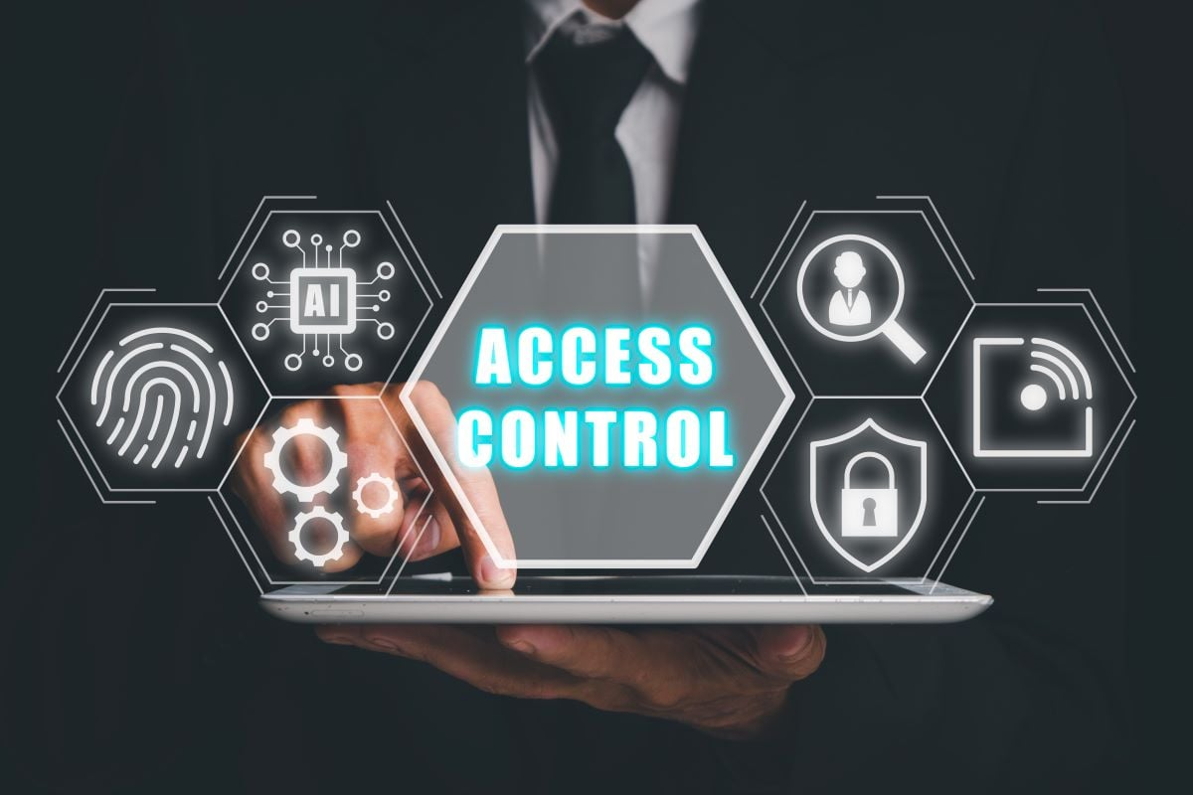
CyBlack Group 1
Prince Kwesi Lassey
Okeke Anthonia Chiamaka
Araga Joachim Omeiza
Enioluwa Oyedemi
Cynthia Chinemerem Ike-Uchendu
Daniel Afolabi

Slide 2
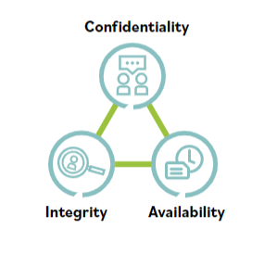
Access Control
A safeguard or countermeasure designed to preserve the CIA Triad by limiting what data is available to whom according to a predefined set of rules. In terms of our task, the rule here is Role-Based Access control, which tends to manage user access to systems and resources based on their roles within an organization.
Image source: ISC2

Slide 3

SCENARIO
You are a junior security analyst reviewing file permissions in the /company directory. Each user should only access the folders relevant to their role. However, some users may have excessive access.
Image Credit: Coursera

Slide 4
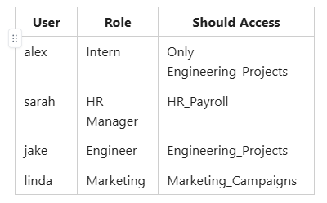
Role-Based Access Control of the Company

Slide 5
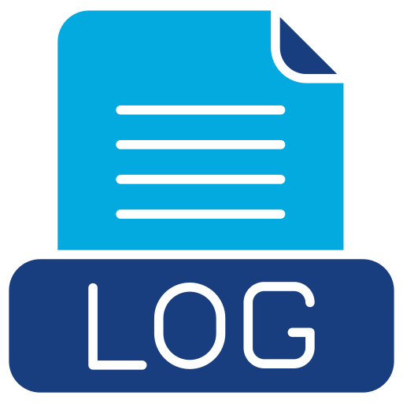

Non-Repudiation
The assurance that someone cannot deny their actions because there’s undeniable evidence tying them to the act. As our Facilitators said, Logs don’t lie.

Slide 6

What Violations Were Identified?
The only violation we identified was Alex who had access to HR_Payroll which should not have been so.
Image Credit: iStock

Slide 7
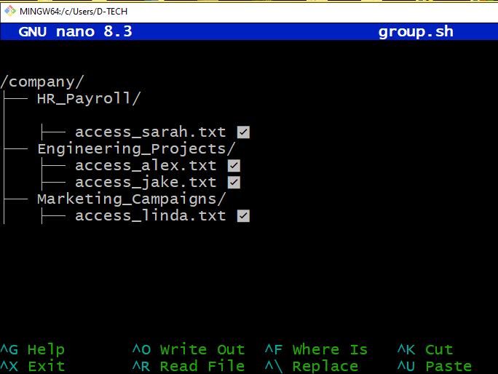
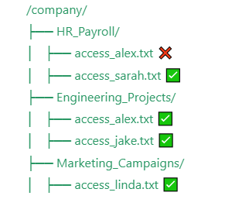
Fixed File Permissions

Slide 8
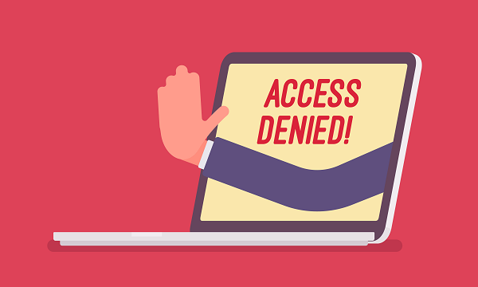
Principle of Least Privilege
Alex’s access to HR_Payroll violated the Principle of Least Privilege because it allowed him access to sensitive HR data irrelevant to his Intern role.
Removing his access aligns with the Principle of Least Privilege, which states that users should only have access to resources necessary for their job functions and nothing more,
Thereby reducing the attack surface and protecting sensitive information
Example: Hospitals

Slide 9
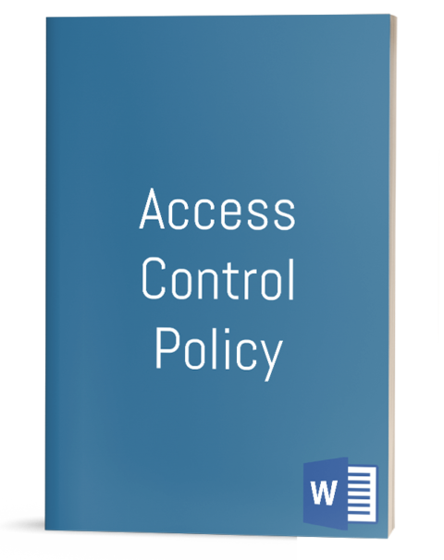
Access Control Policy
We then made a set of rules and guidelines that define how users can access resources within the organization in compliance with the ISO 27001 Standard
Image Source: IT Procedure Template

Slide 10
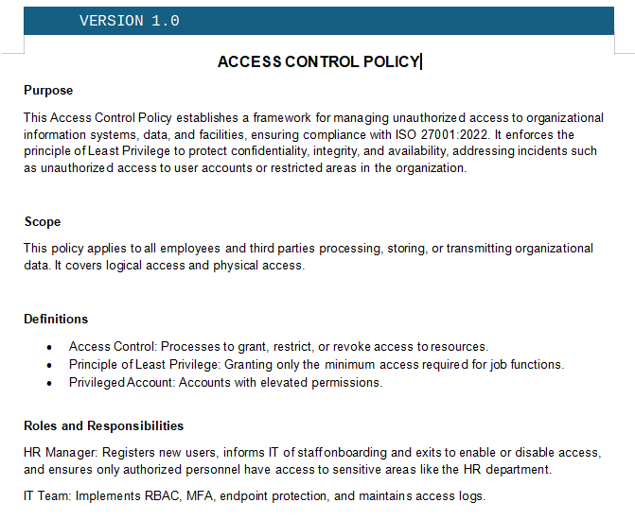
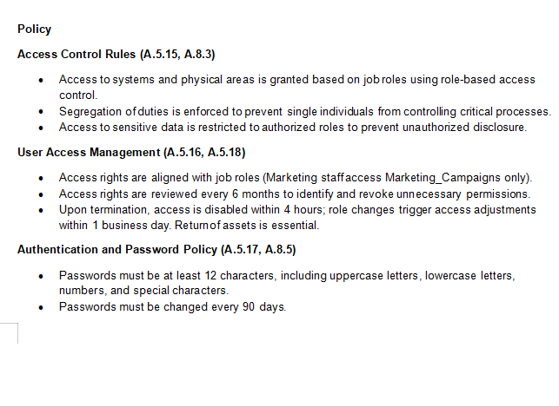
What’s the Policy About?

Slide 11
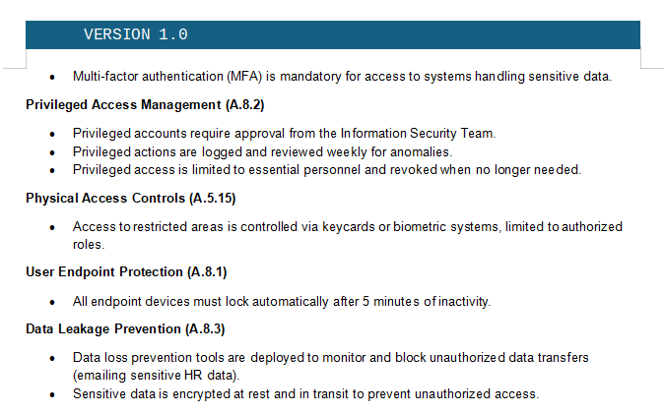
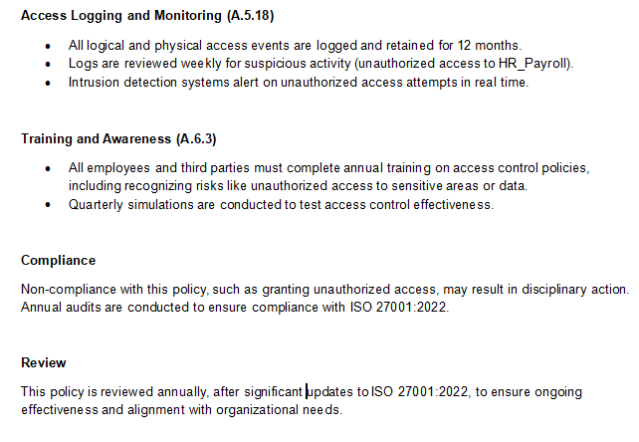
What’s the Policy About?

Slide 12
